Slide 1


Image Analysis on ImageJ
Matheus Viana, IBM Research Brazil

Slide 2
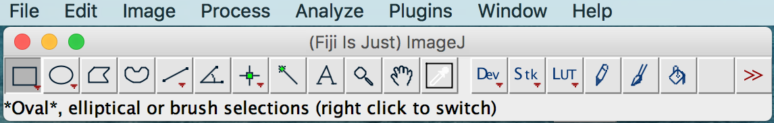
About ImageJ
Great open-source environment for serious research
Huge number of plugins ready to use
Continuously growing

Slide 3
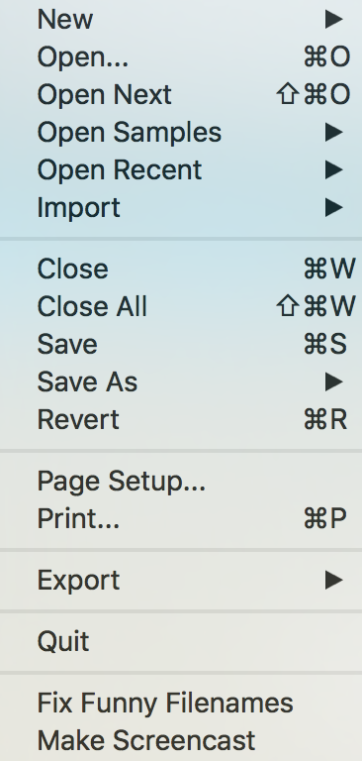
About ImageJ
Import pretty much any image type
Export pretty much to any image type

Slide 4
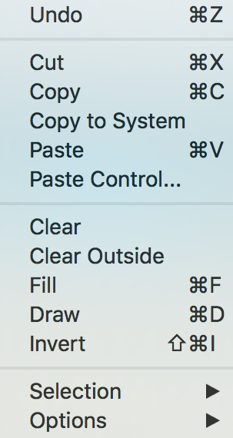
About ImageJ
Copy/Paste
Copy to System
Important when dealing with ROIs

Slide 5
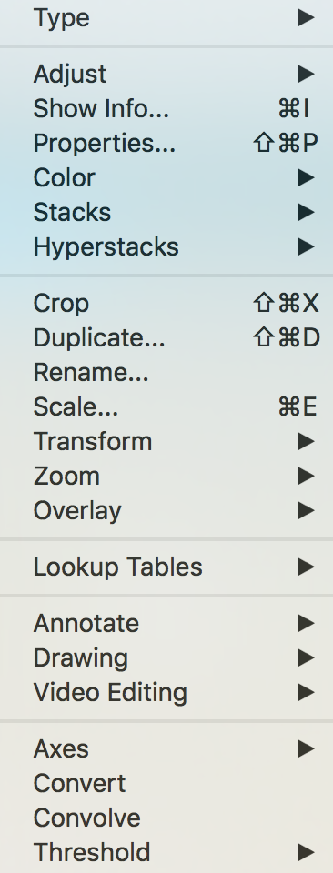
About ImageJ
Type convertion (8bits, 16bits, RGB)
Merge and split channels
Stack: Max projections
Scale, rotate, flip

Slide 6
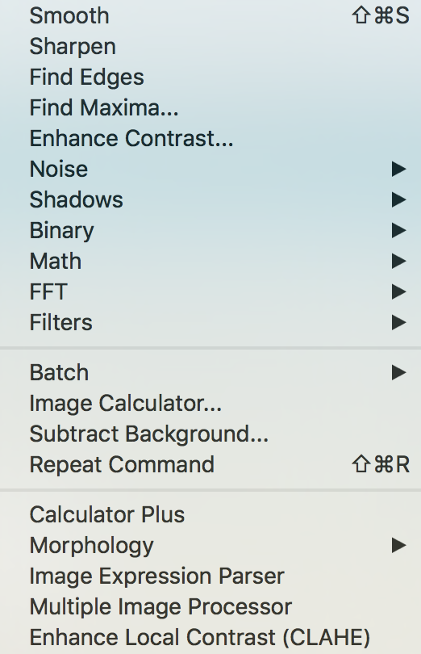
About ImageJ
Smooth, sharpen, find edges
Image operations: sum, multiplication
Morphological operations: erode, dilate

Slide 7
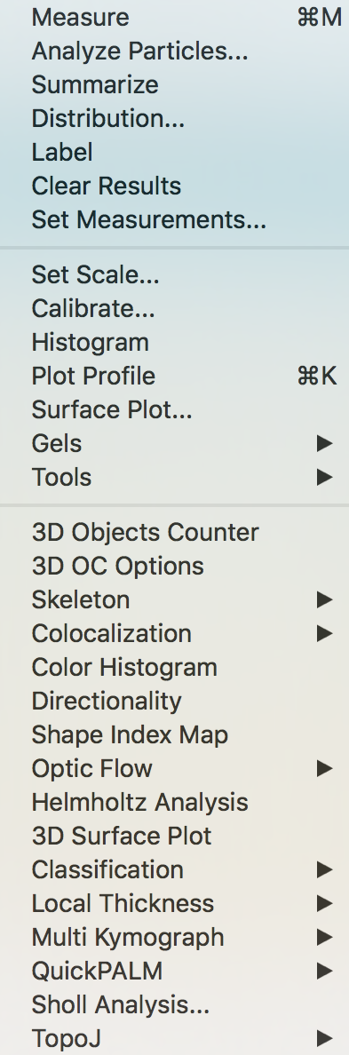
About ImageJ
Feature extraction
Plugins incorporated into ImageJ

Slide 8
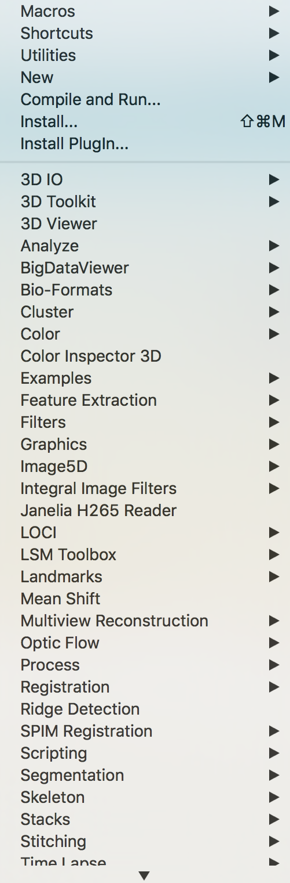
About ImageJ
Macros programming
Ready to use plugins

Slide 9
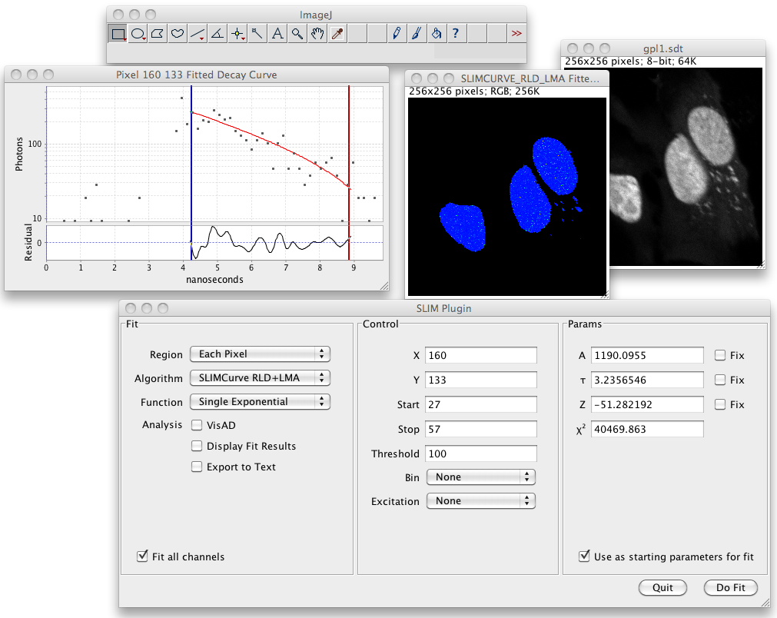
Some plugins
Spectral lifetime image analysis

Slide 10
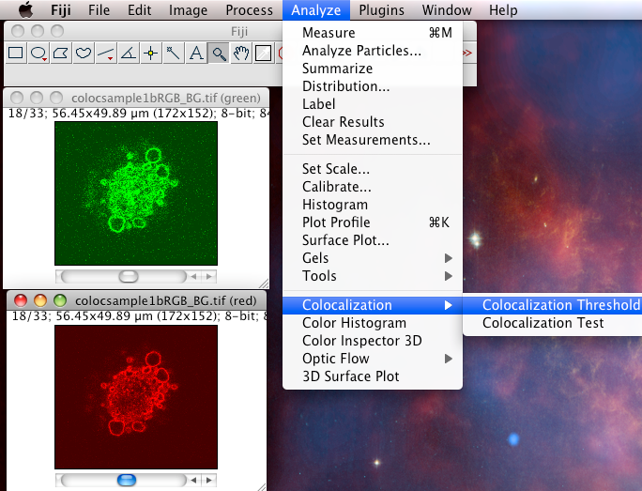
Some plugins
Colocalization

Slide 11
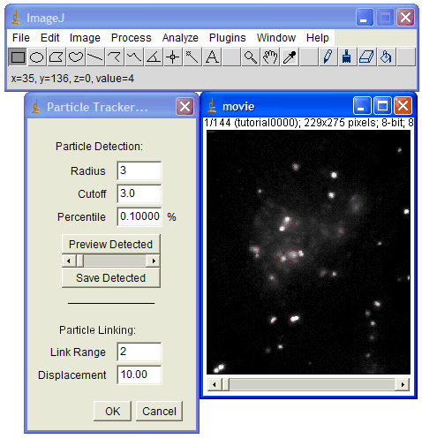
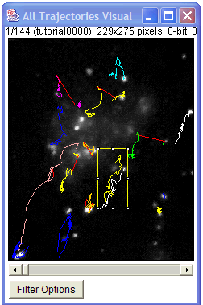
Some plugins
Particle tracking

Slide 12
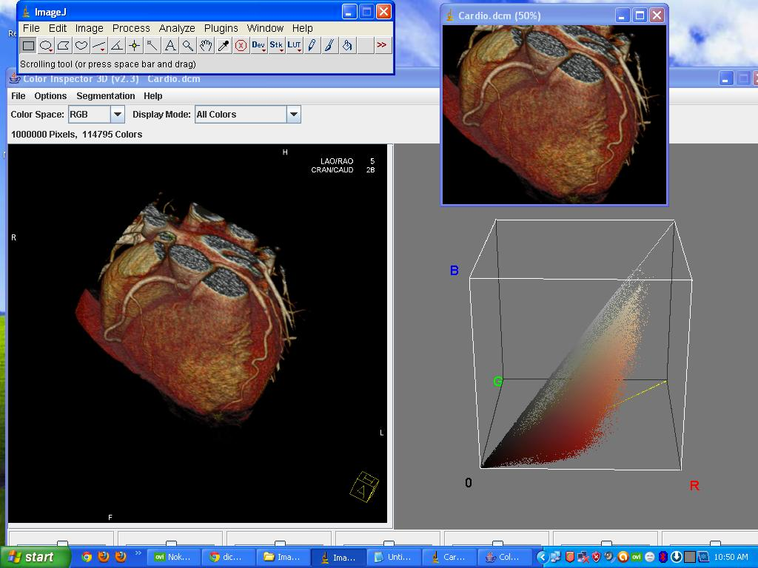
Some plugins
3D visualization

Slide 13
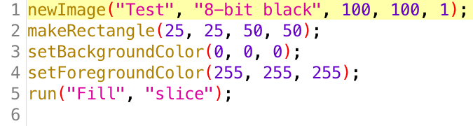
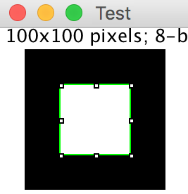

Let’s start coding
File ↪ Open: Macro1.ijm
How do I know the commands?
Built-in Macro Functions - RSB Home Page
https://imagej.nih.gov/ij/developer/macro/functions.html
Or…

Slide 14
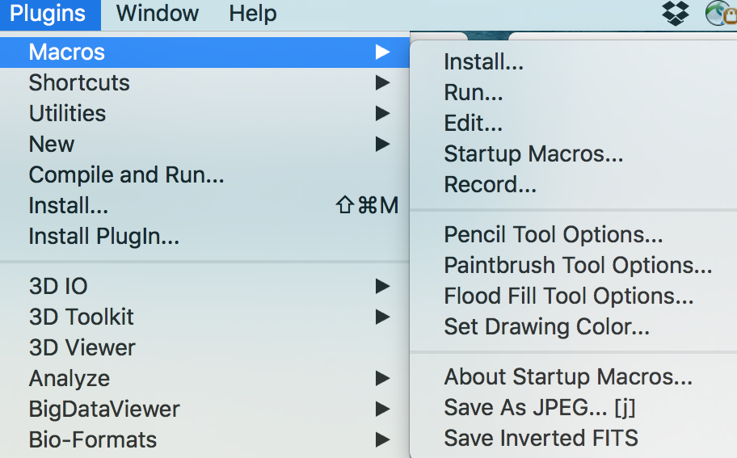
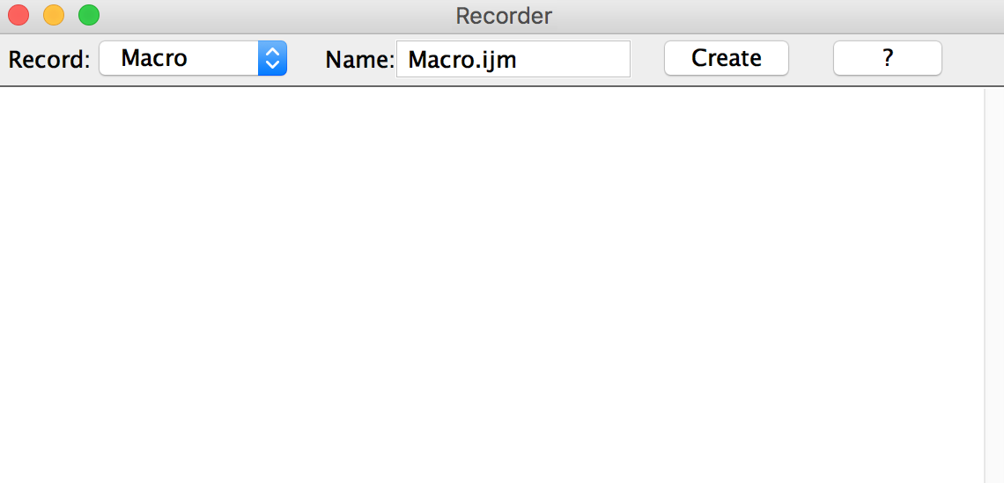
Let’s start coding

Slide 15
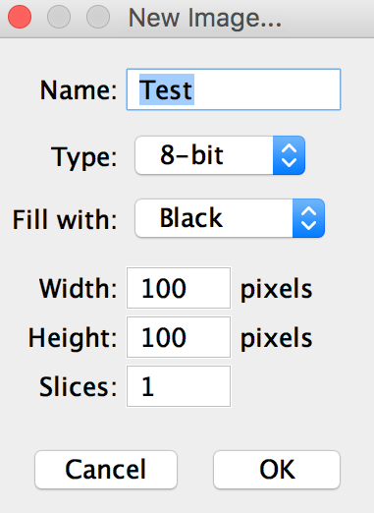

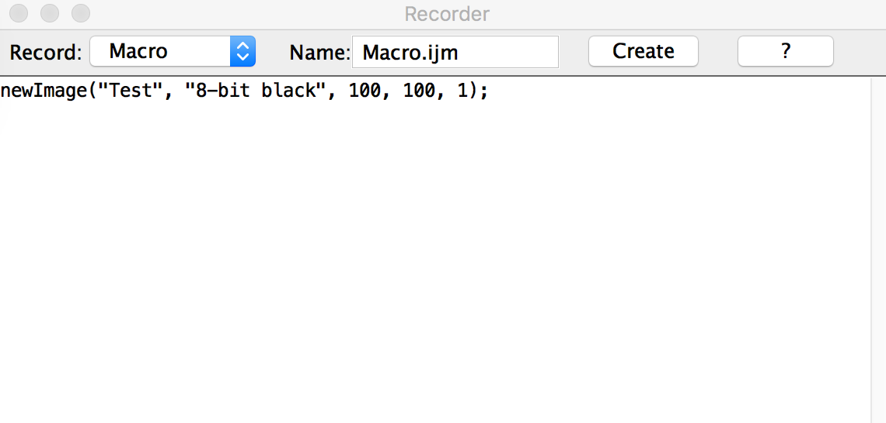
Let’s start coding
File ↪ New ↪ Image

Slide 16
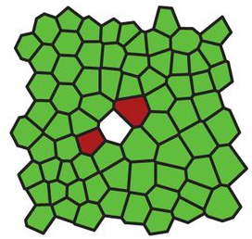
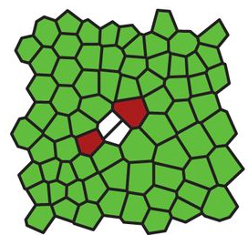
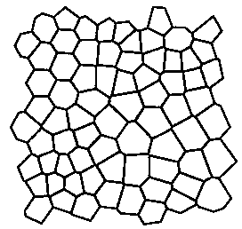
Towards automatic detection of cell division
T = 1
T = 2
T = …
…
Cell segmentation
Cell tracking
Track analysis

Slide 17
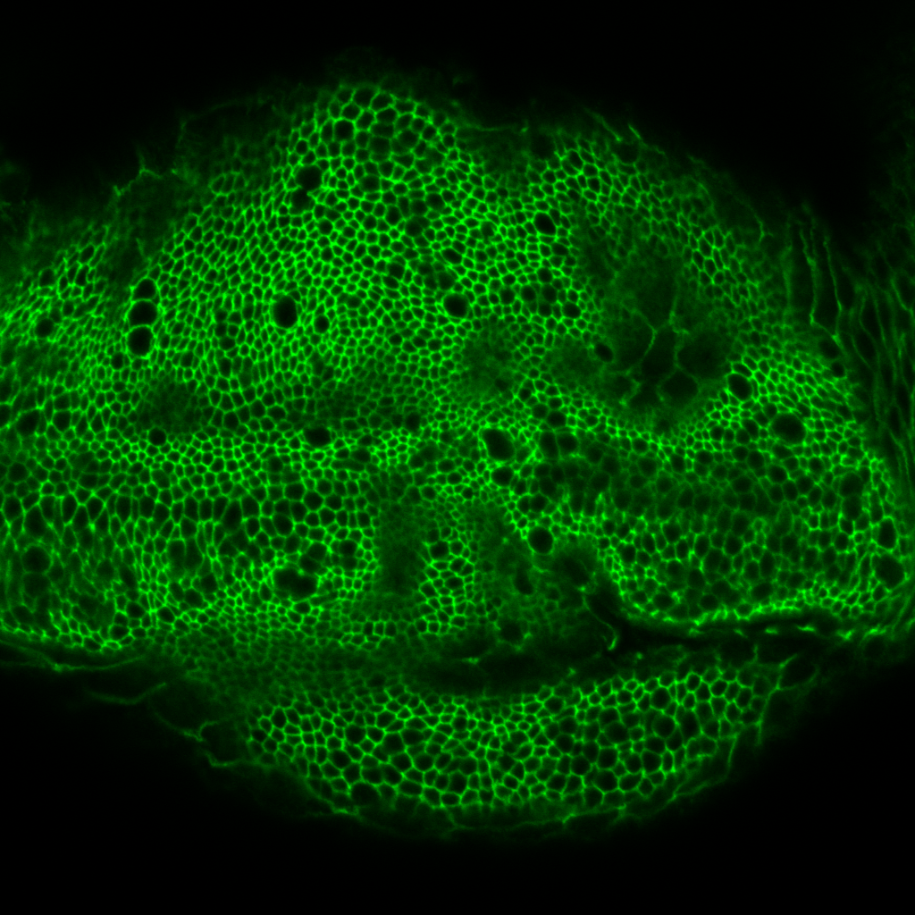
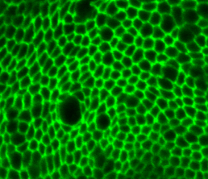
Towards automatic detection of cell division
Thanks to Carmen Candia and Marcos Nahmad

Slide 18
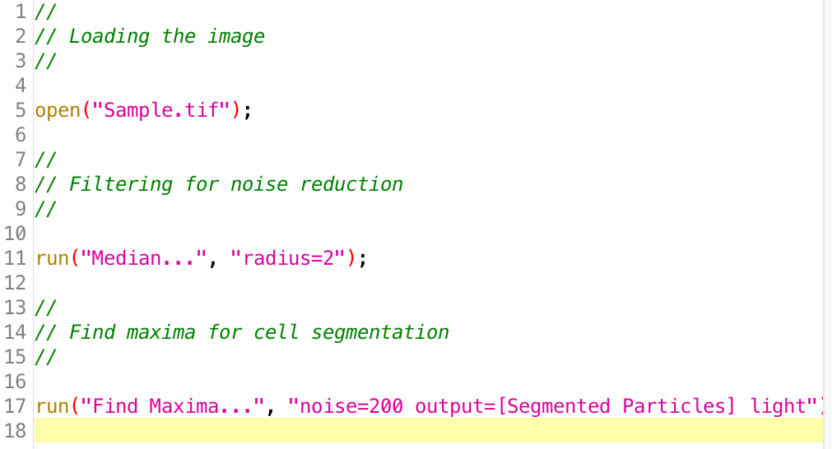
Automatic cell segmentation: Macro2.ijm
Comments
Comments
Comments

Slide 19
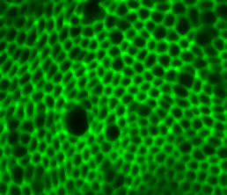
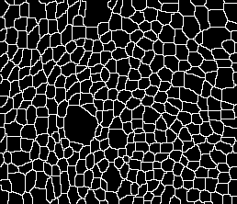
Automatic cell segmentation
Original Image
Noise reduction
Maxima Identification

Slide 20
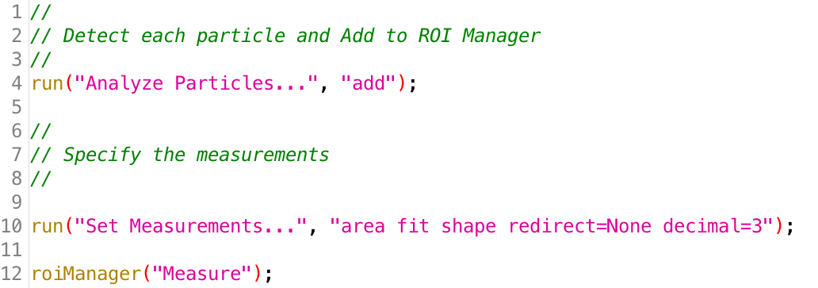
Feature extraction: Macro3.ijm

Slide 21
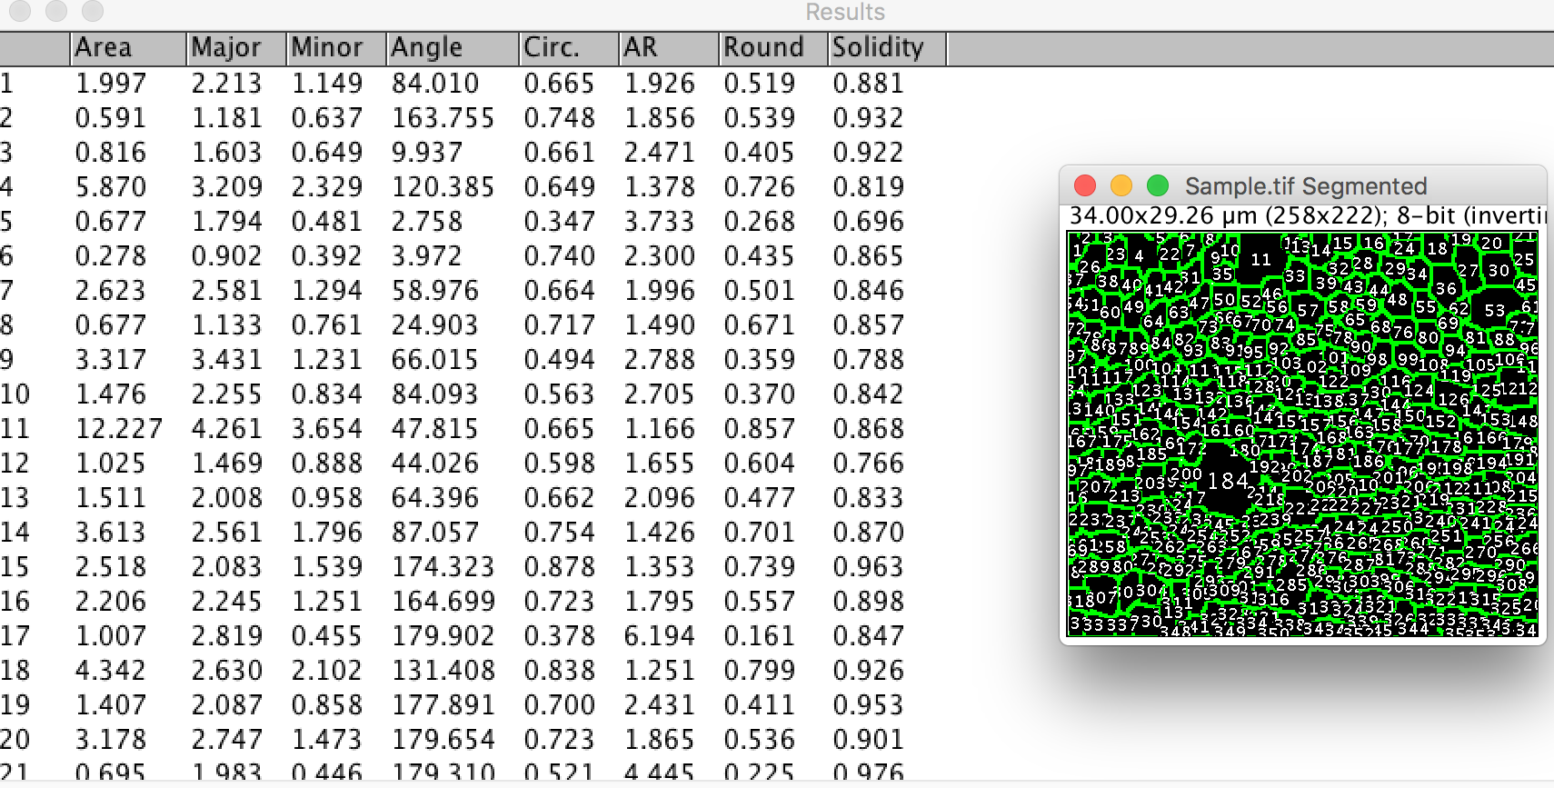
Feature extraction: Macro3.ijm
Number of pixels

Slide 22
Feature extraction: Macro3.ijm
Ellipse major axes

Slide 23
Feature extraction: Macro3.ijm
Ellipse minor axes

Slide 24
Feature extraction: Macro3.ijm
Ellipse orientation

Slide 25
Feature extraction: Macro3.ijm
Circularity (1 for circle)

Slide 26
Feature extraction: Macro3.ijm
Aspect ratio (Major/Minor)

Slide 27
Feature extraction: Macro3.ijm
Roundness (inverse of AR)

Slide 28
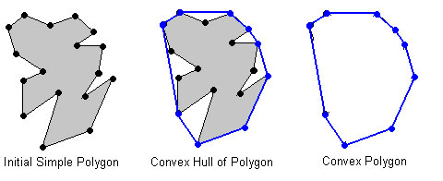
Feature extraction: Macro3.ijm
Area / Convex Area

Slide 29
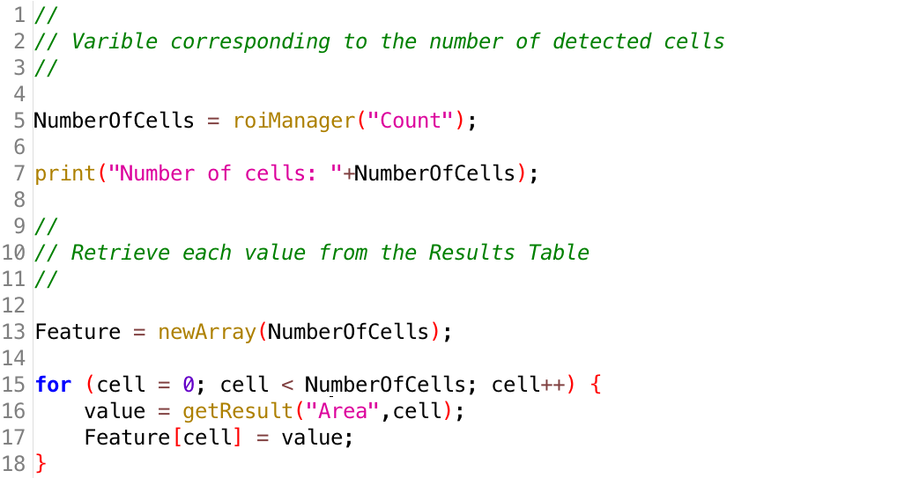
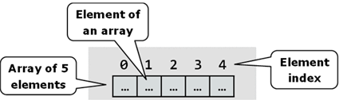
Displaying the results: Macro4.ijm

Slide 30
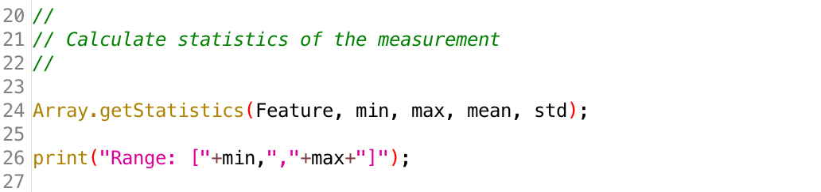
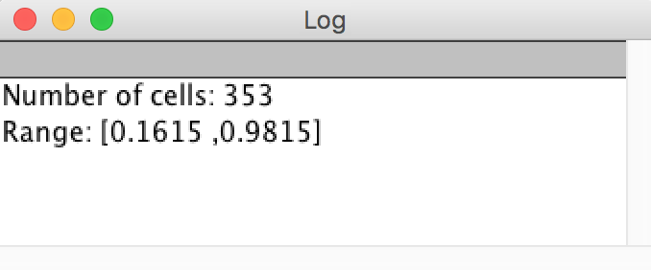
Displaying the results: Macro4.ijm

Slide 31
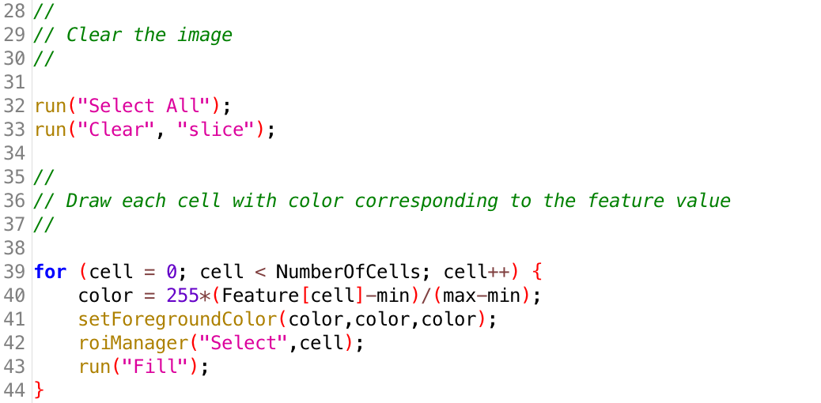
Displaying the results: Macro4.ijm

Slide 32
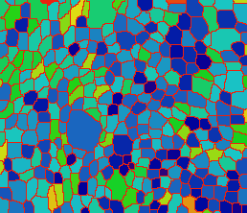
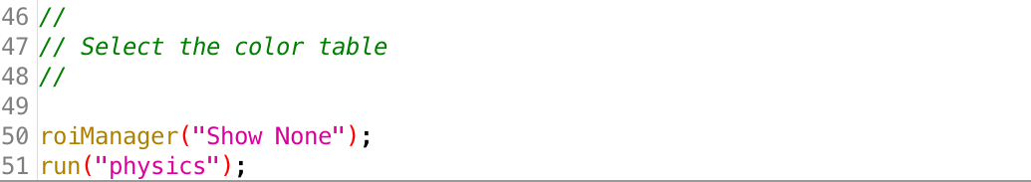
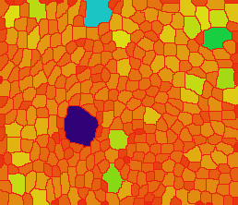
Displaying the results: Macro4.ijm

Slide 33
Macro5.ijm: All together
Can you change Macro5.ijm to color the cells according to their aspect ratio instead of Area?
Thanks. Any questions?

